Slide 1



Pizza sales 2015
View in Power BI
Last data refresh:
4/19/2023 8:50:28 AM UTC
Downloaded at:
4/19/2023 8:53:00 AM UTC

Slide 2
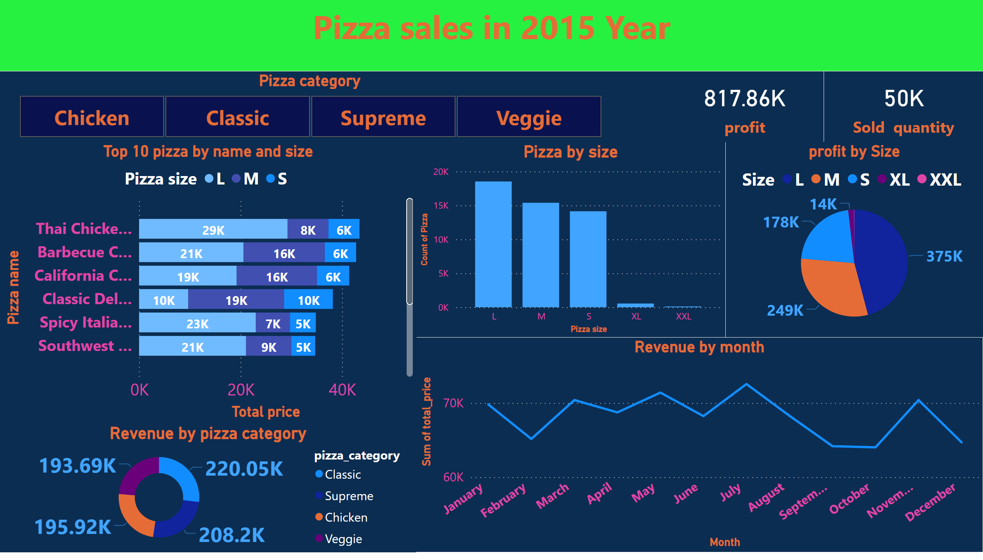
Pizza sales
Notes:
card
No alt text provided
card
No alt text provided
pieChart
No alt text provided
Pizza category
No alt text provided
Pizza by size
No alt text provided
card
No alt text provided
textbox
No alt text provided
Revenue by month
No alt text provided
Top 10 pizza by name and size
No alt text provided
Revenue by pizza category
No alt text provided

